Slide 1


Adapted Governance Regulation (EU 2018/1999)
Reportnet3 training for the dataflows on adaptation
Aneliya Nikolova (EEA)
8 October 2025
Sarajevo | Bosnia and Herzegovina
©TPeter Vadocz, Urban Treasures EEA

Slide 2




Your Adapted GovReg Team
Per Wretlind
EEA
Energy Community Project Manager
Aneliya Nikolova
EEA Data custodian for
adaptation dataflows,
Energy Community and EU MS
Monika Figaj
Energy Community Secretariat, PoC for adaptation reporting

Slide 3
Agenda
9:00 – 9:30 Introduction
Technical aspects of reporting
Finalizing the reporting
Q&A
9:30 – 10:30 Thematic aspects of reporting - Article 19
Q&A
Break
10:45 – 11:30 Thematic aspects of reporting - Article 17
Q&A
11:30 – 12:00 Next steps
©TPeter Vadocz, Urban Treasures EEA
Notes:
EnCS setting the scene
Split into blocks to allow for questions and breaks
Changes in technicalities in the system in the Art 19 dataflow

Slide 4

Legislation
and timeline

Slide 5
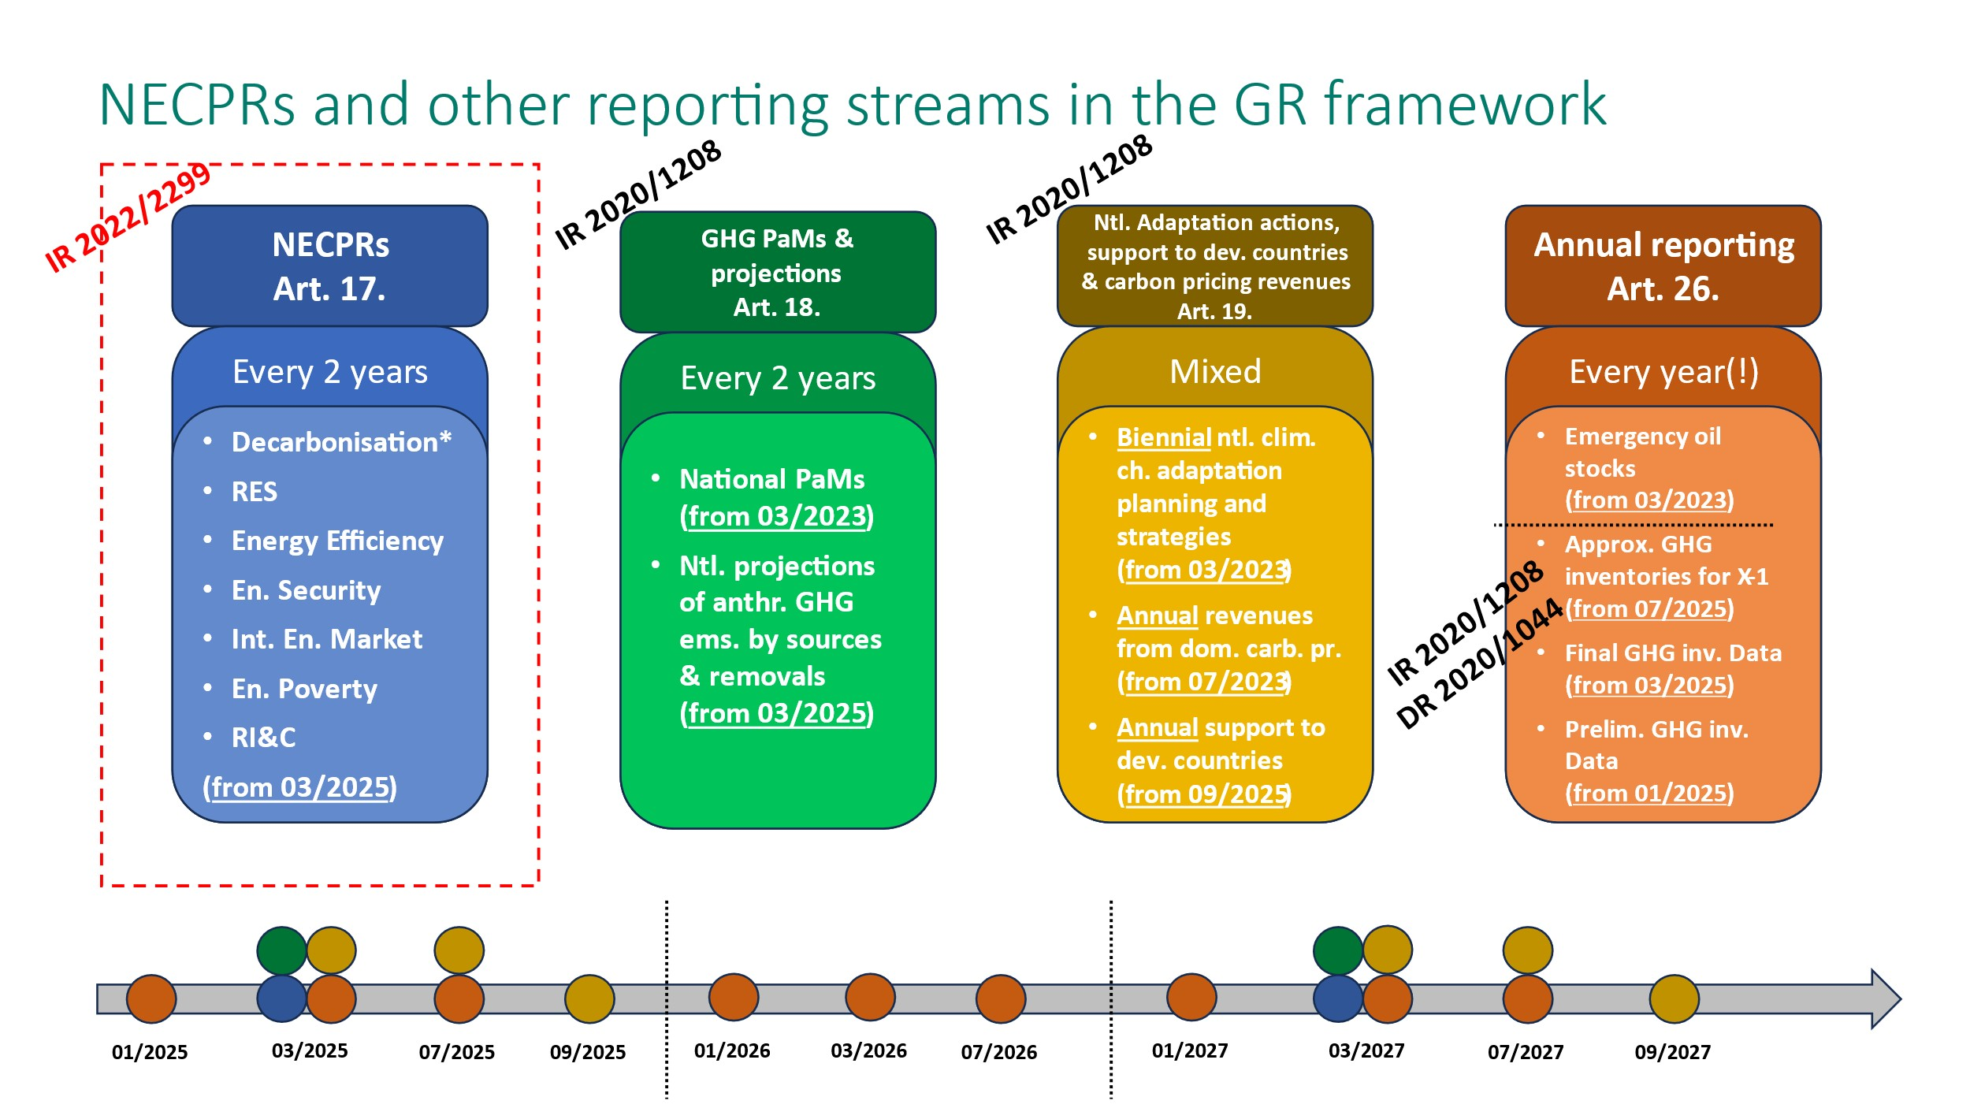
NECPRs and other reporting streams under the GovReg

Slide 6

Legislative Framework
Regulation (EU) 2018/1999 on the Governance of the Energy Union and Climate Action incorporated and adapted by the ministerial council decision 2021/14/mc-enc of 30 november 2021
Article 17 Integrated national energy and climate progress reports
Article 19 Integrated reporting on national adaptation actions
IMPLEMENTING REGULATION (EU) 2020/1208 on structure, format, submission processes and review of information reported by Member States pursuant to Regulation (EU) 2018/1999
Article 4 and Annex I - Reporting on national adaptation actions
IMPLEMENTING REGULATION (EU) 2022/2299 as regards the structure, format, technical details and process for the integrated national energy and climate progress reports
Annex III Decarbonisation - Adaptation progress reporting
EUR-Lex - 32022R2299 - EN - EUR-Lex
EUR-Lex - 32022R2299 - EN - EUR-Lex
©TPeter Vadocz, Urban Treasures EEA
Notes:
Emphasize that Art 17 reporting on adaptation is part of the NECPR

Slide 7
Adapted Governance Regulation
COMMISSION IMPLEMENTING REGULATION (EU) 2020/1208
on structure, format, submission processes and review of information reported by Contracting Parties (CPs) pursuant to Regulation (EU) 2018/1999 incorporated and adapted by the Ministerial Council Decision 2021/14/MC-EnC of 30 November 2021
Article 4 and Annex I - Reporting on national adaptation actions
National circumstances, impacts, vulnerabilities, risks and adaptive capacity
Legal and policy frameworks and institutional arrangements
Adaptation strategies, policies, plans and goals
Monitoring and evaluation of adaptation actions and processes
Cooperation, good practices, synergies, experience and lessons learned in the field of adaptation
Any other information related to climate change impacts and adaptation
COMMISSION IMPLEMENTING REGULATION (EU) 2022/2299
laying down rules for the application of Regulation (EU) 2018/1999 as regards the structure, format, technical details and process for the integrated national energy and climate progress reports incorporated and adapted by the Ministerial Council Decision 2024/01/PHLG-EnC of 11 December 2024
Article 2 and Annex III - Reporting on progress with respect to the decarbonisation dimension
CPs shall report the information on adaptation referred to in Article 4, point (a)(1) of Regulation (EU) 2018/1999 in accordance with the formats set out in Annex III.
Annex III – Decarbonisation: Adaptation
Table 1 Adaptation goals in integrated national energy and climate plans
Table 2 Information on adaptation, which may affect delivery of Energy Union objectives and targets and the long-term Union GHG emission reduction commitments under the Paris Agreement
Notes:
Emphasize key differences between the two dataflows
Art 19 – 6 building blocks
Art 17 – 2 tables: 4 mandatory questions on table 2 on the decarbonisation dimension, including voluntary fields and opportunity to report on all dimensions of the Energy Union

Slide 8






Timeline of the 2025 reporting cycle – deadline 15 March
15/03/2025 - reporting
deadline
Datasets
published
Mar.
Apr.
May
Jun.
Jul.
Aug.
Sept.
Oct.
Quality assurance and voluntary feedbacks shared
Voluntary resubmissions
Dashboards
published
Data use in the EnCS / EEA products
Preparation of CP submission
Notes:
Deadline for both dataflows – March 15: beware that this is the same deadline for many other dataflows and the system will be overloaded. Validations and submissions will take longer as you enter a queue when you press the button.
The EEA conducts data analysis and prepares inputs for the EnCS and CPs. Focus on strengthening quality of reporting.

Slide 9
Accessing Reportnet3
Technical aspects of reporting

Slide 10
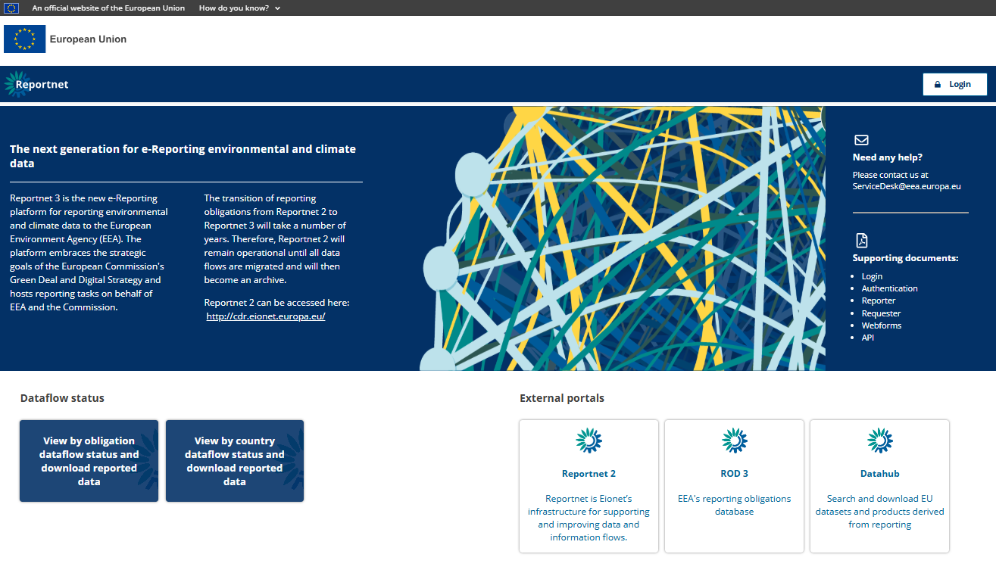
Reportnet 3

Slide 11
Helpdesk
aneliya.nikolova@eea.europa.eu
First point of contact
Thematic issues with data input
Information on renomination of lead reporters
All dataflow experts will respond via this mailbox
OR
servicedesk@eea.europa.eu
IT/Technical Reportnet issues (crashes, bugs etc.)
©TPeter Vadocz, Urban Treasures EEA

Slide 12
Lead and supporting reporters
Example scenario 1
Example scenario 2
GHG PaMs Dataflow
Adaptation
National Systems
Carbon Revenues
GHG PaMs Dataflow
Adaptation
National Systems
Carbon Revenues
Lead Reporter 1
Lead Reporter 1 (Ministry of Environment)
Lead Reporter 3 (Ministry of Environment, adaptation)
Lead Reporter 1 (Ministry of Environment)
Lead Reporter 1 (Ministry of Environment)
Lead Reporter 2
Person from the Meteo Institute
Person from the Ministry of Finance
Lead Reporter 2 (Ministry of Energy)
Lead Reporter 3 (Ministry of Finance)
Person from the Min. Of Env.
Person from the Min. Of Ene.
Person from the Meteo Institute
Lead reporters – Oversee the reporting task under dataflows assigned to them.
Have read/write rights;
Can assign Supporting reporters;
Can submit (release) data to the EEA/EnCS.
Supporting reporters – Review or input data.
Have read or read/write rights.

Slide 13
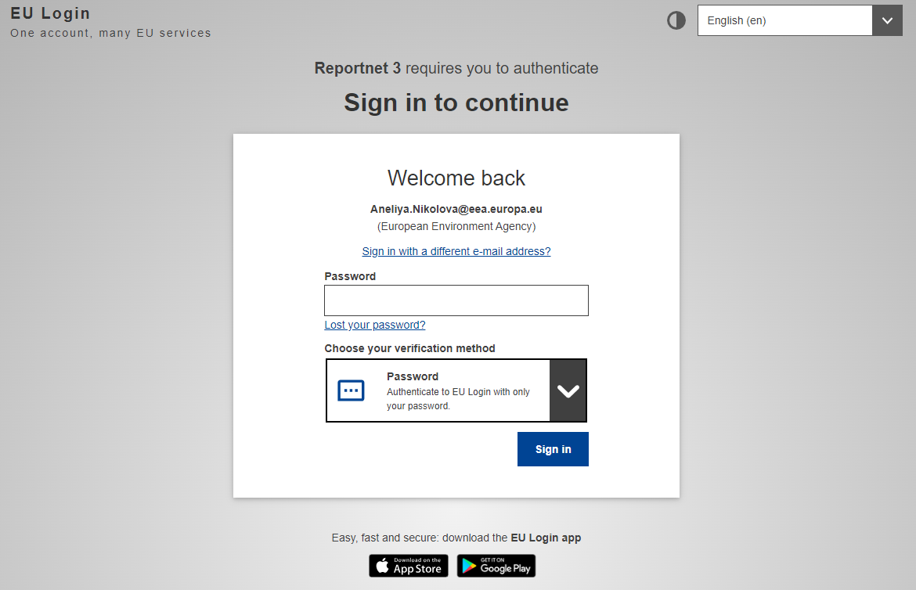
Getting started – EU Login
User authentication is carried out on the EU login platform; hence you need to have an EU login account before you can be authenticated for Reportnet3 access.
Regular login process: Where you already have an EU account and you have logged on to Reportnet3 before,
Creating an EU login account: Where you do not have an EU account,
Logging on for the first time: Where you have an EU account, but you have not logged on to Reportnet3 before.
For a visual guide, please check this document.

Slide 14
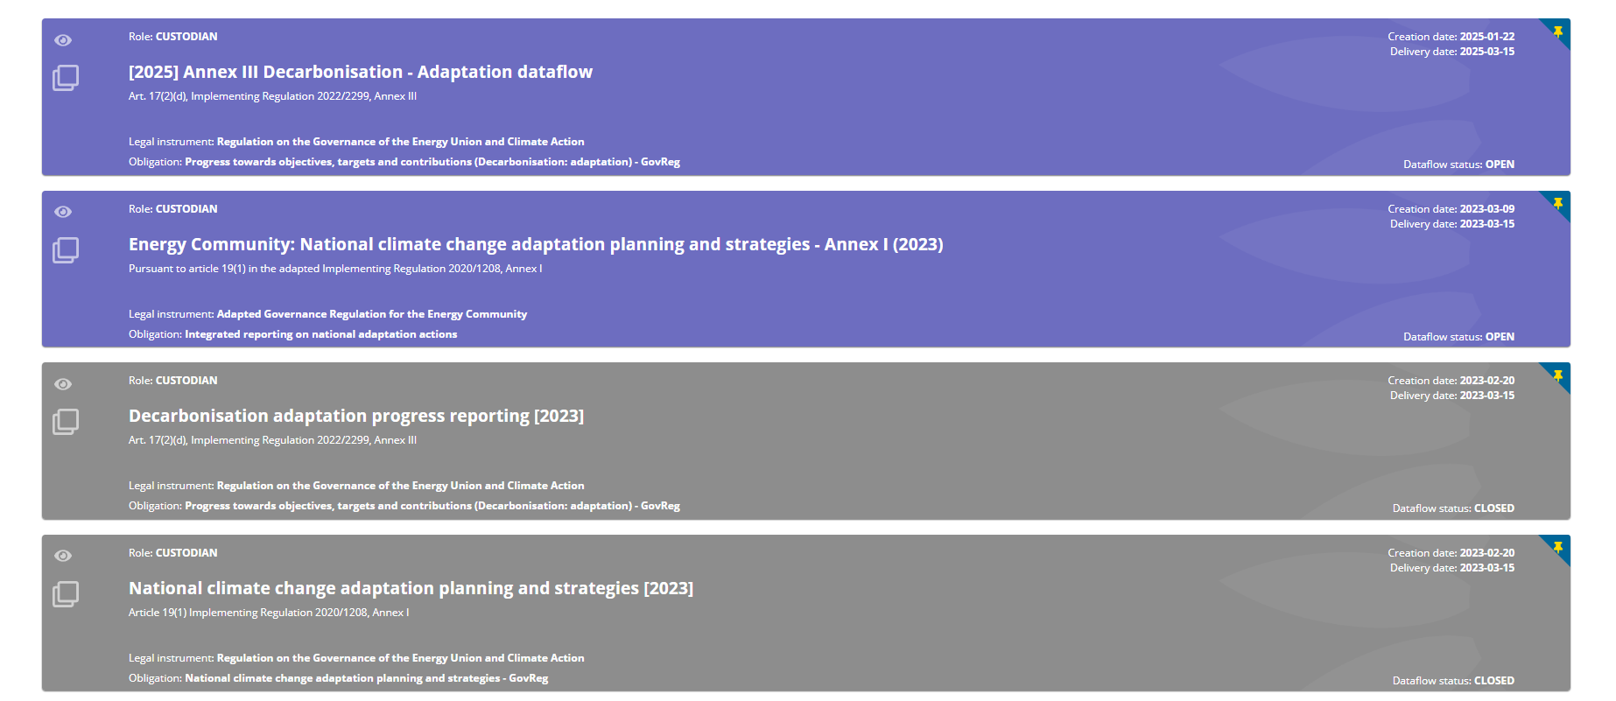
The adaptation dataflows

Slide 15
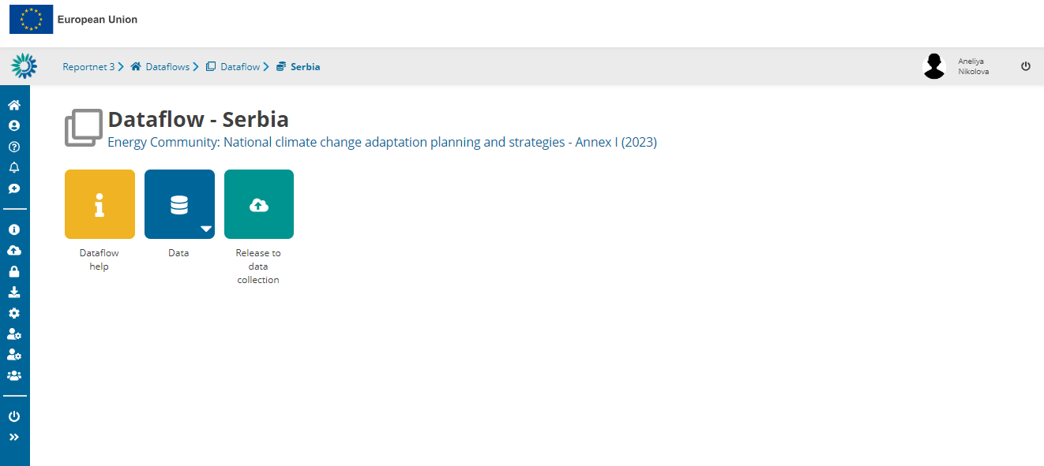
Dataflow overview I
Dataflow Help
Reporting guidelines and documentation
Useful weblinks
(Dataset schema)
DATA
Core of the reporting, with webforms and tables
Release to DATA collection
Only for lead reporters
Final step, submitting the reported information

Slide 16
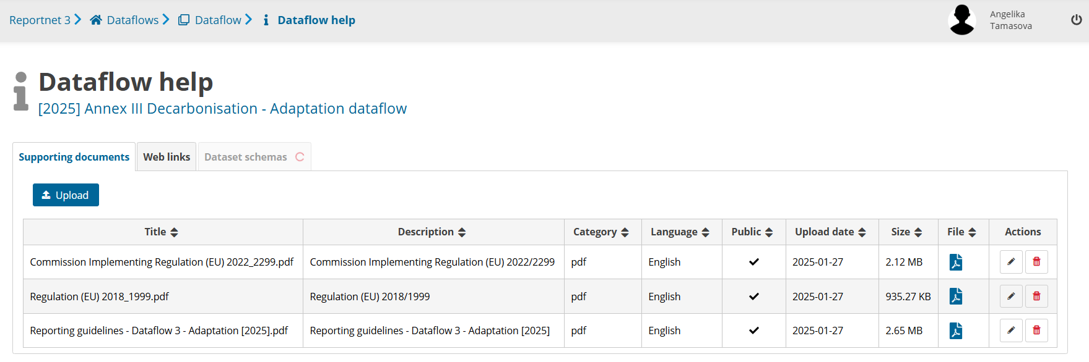
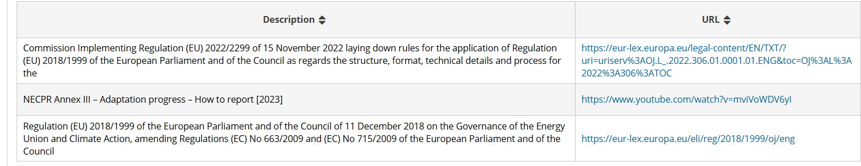
Dataflow overview II
!

Slide 17
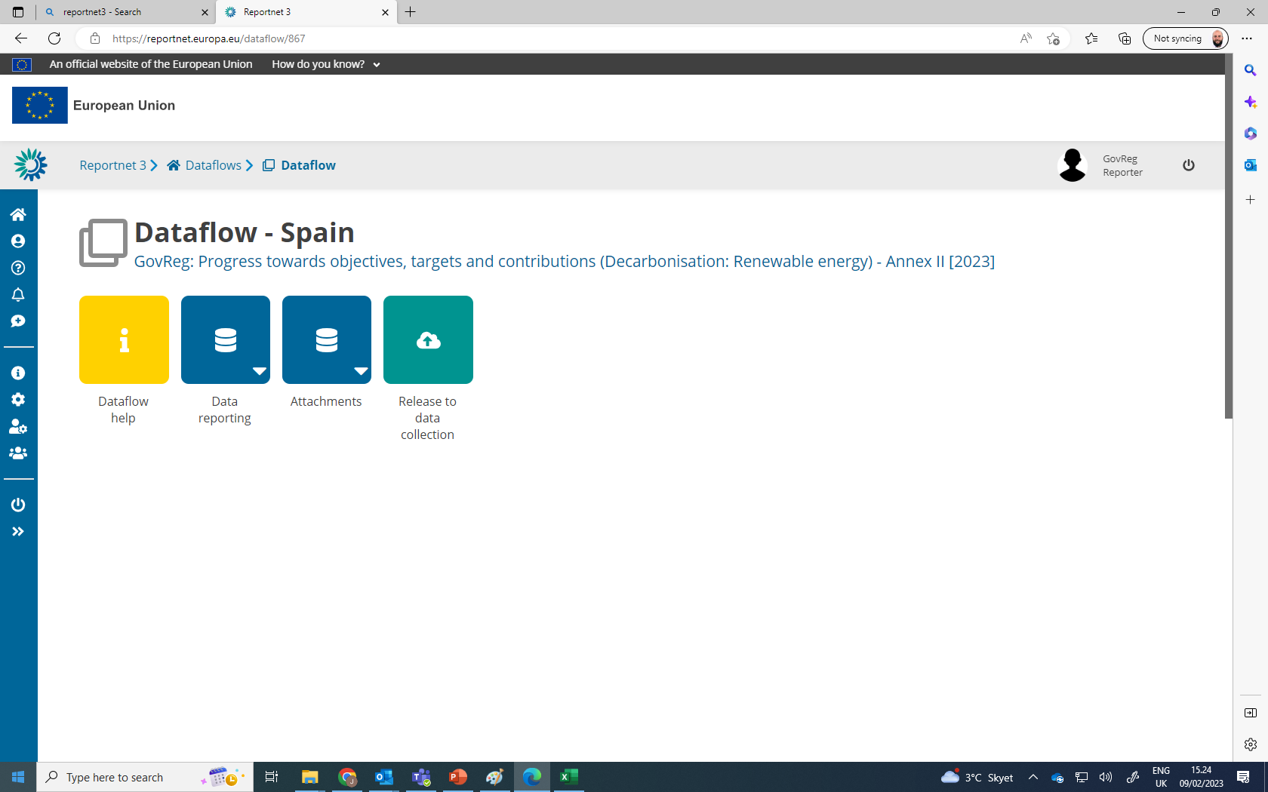
Dataflow overview III
Notifications:
Chronologic overview of processes (messages also in pop-up menus)
E.g. begin and end of validation, reporter management
Info – Success – Error
Dataflow user list:
View who is selected as reporters
Manage reporters (as lead reporter):
Add additional reporters to access dataflow
Reporters cannot release to data collection
Reporter read – reporter write

Slide 18

Finalizing the reporting
Validation and submission

Slide 19
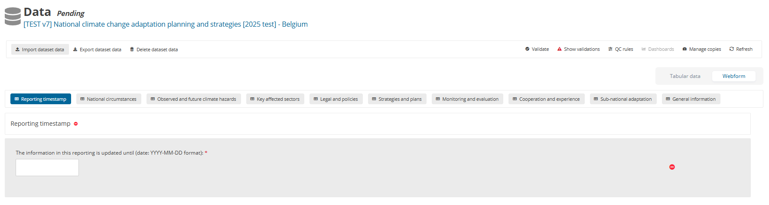
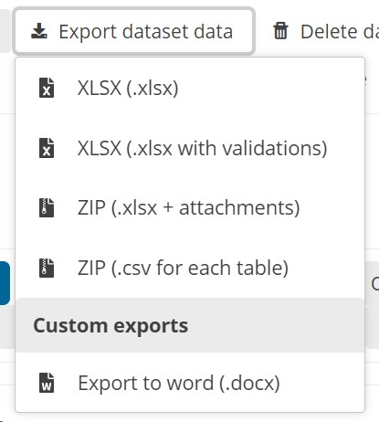
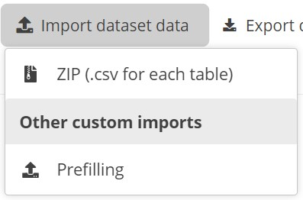
From prefilling towards data validation
2
3
1
4
Prefilling is only possible if data was submitted in 2023.

Slide 20
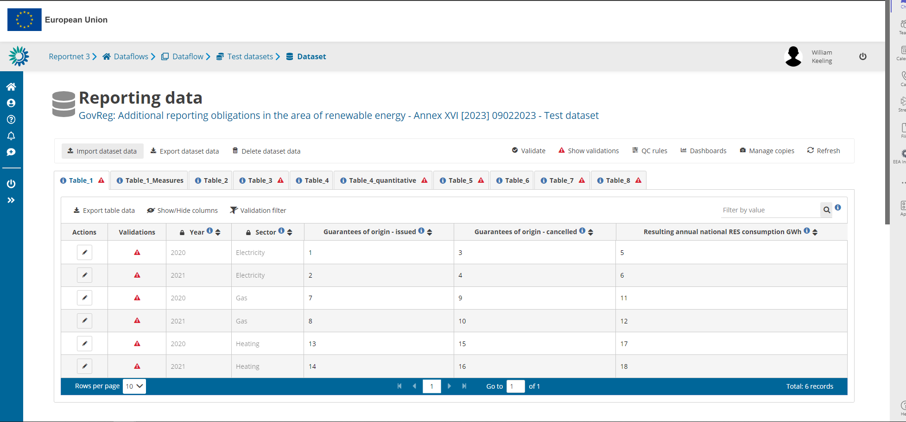
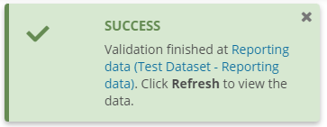
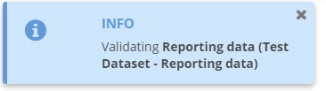
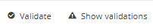

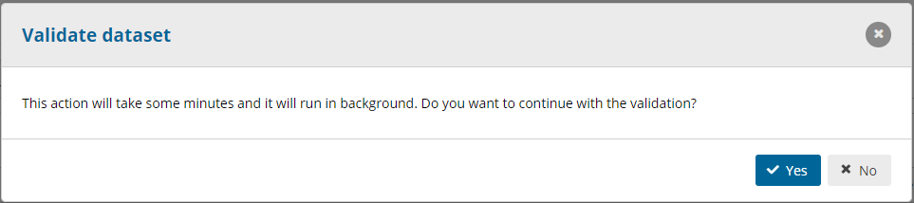
Validation
Add any number of slides for print screens for this Section
`

Slide 21




Information (can release data)
Warning (can release data)
VALIDATION
Blocker (can’t release data)
Error (can’t release data)
Notes:
Blocker – serious issues, the data cannot be submitted
Error – the data may be released but some explanation is required. Please note, errors should be avoided. You should submit a dataset with errors only under exceptional circumstances
Warning – less serious issues, does not prevent the data to be submitted
Information – minor issues or simple notifications

Slide 22
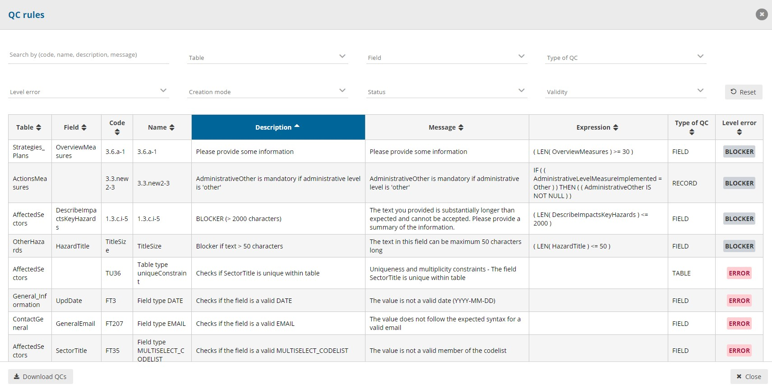
QC Rules

Slide 23
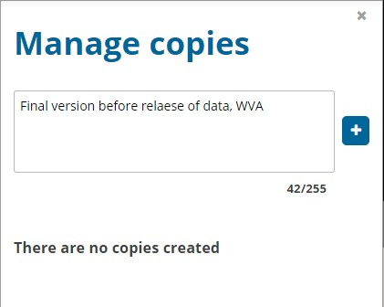
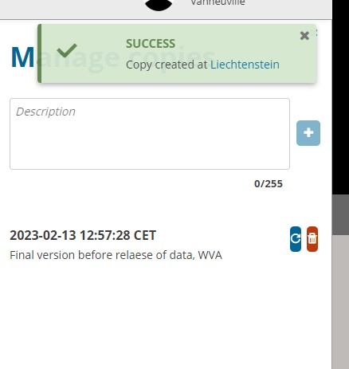
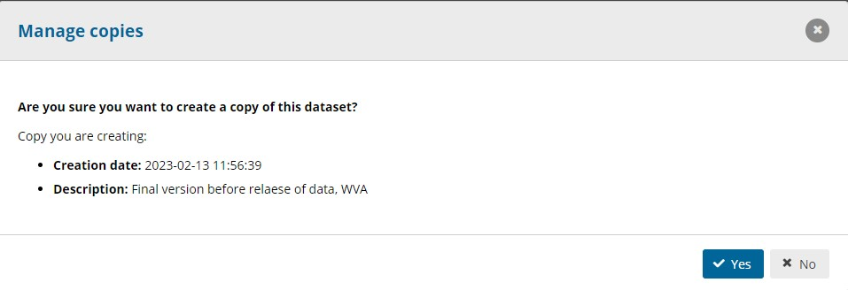
Manage copies

Slide 24
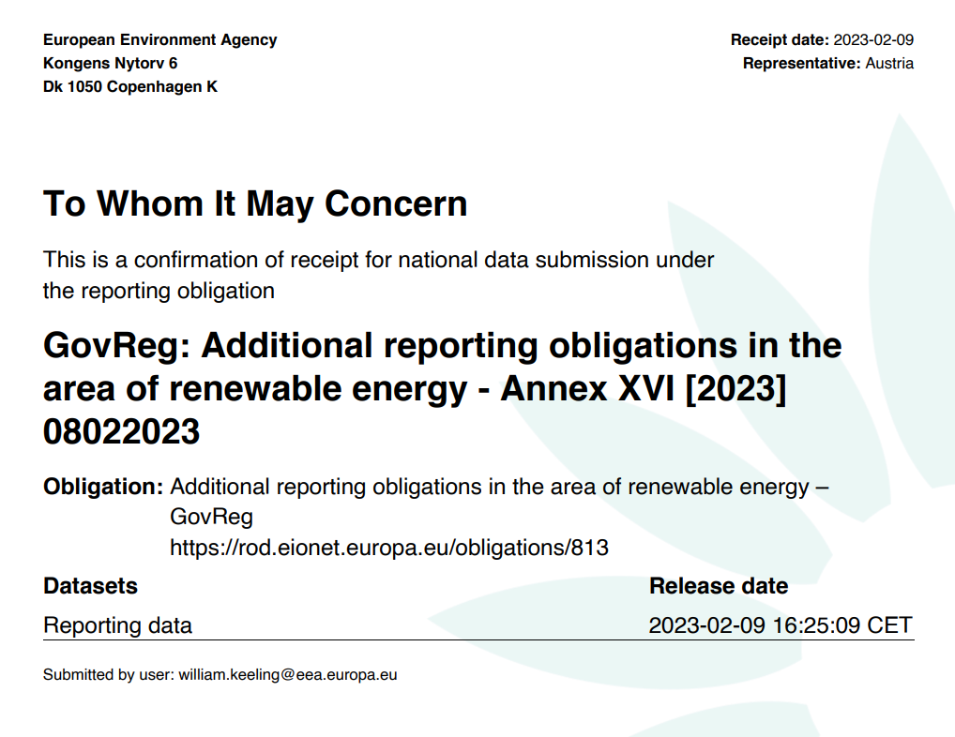
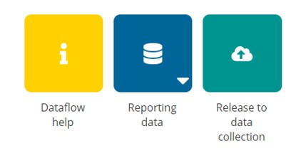
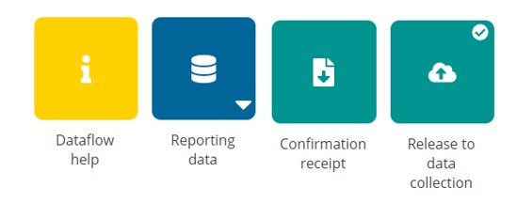
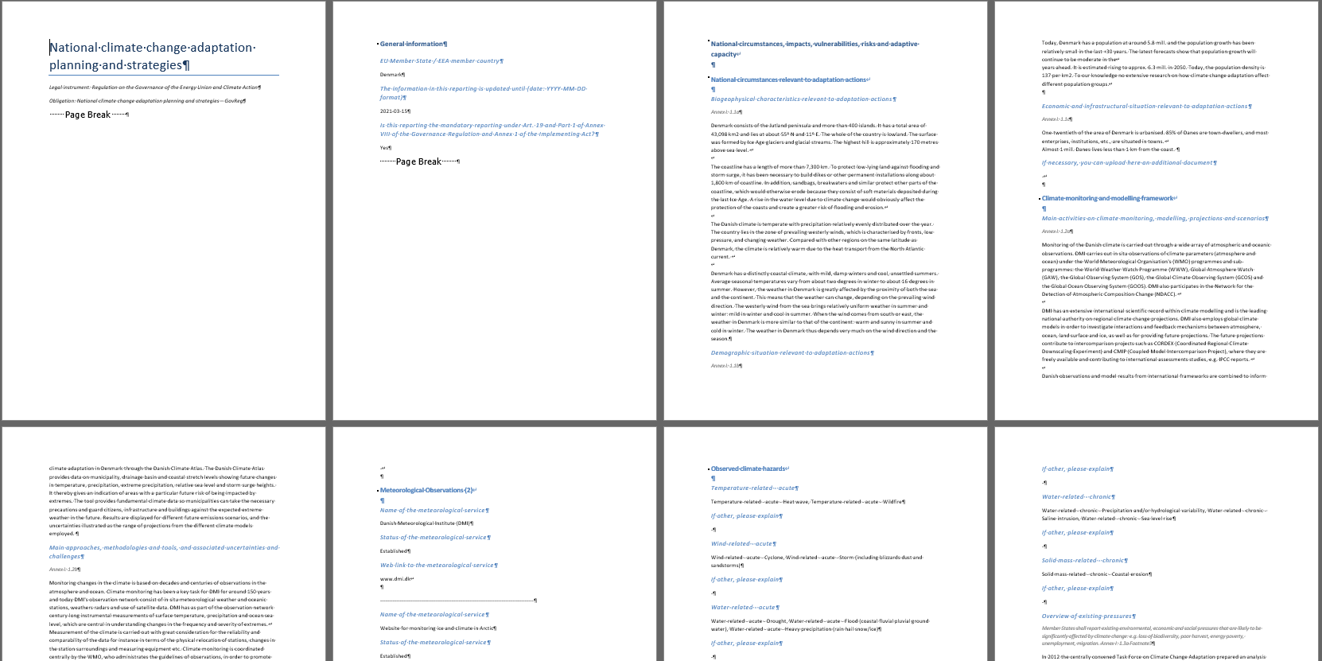
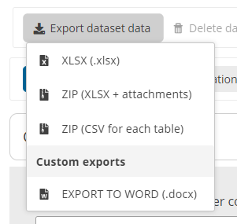
Data submission

Slide 25

Q&A

Slide 26
Reporting on GovReg Article 19
National climate change adaptation planning and strategies
©TPeter Vadocz, Urban Treasures EEA

Slide 27
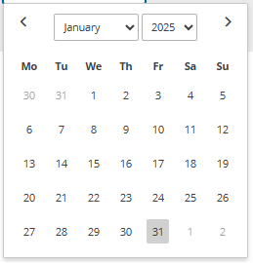
REPORTING TIMESTAMP

Slide 28
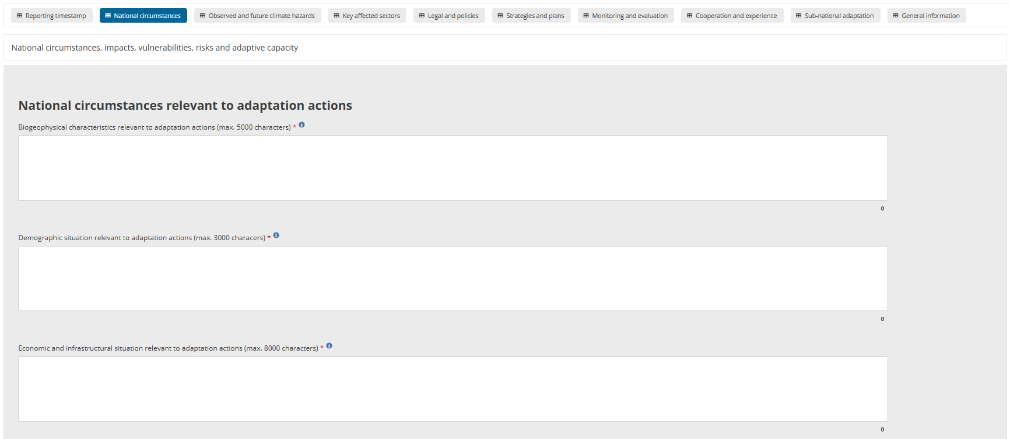
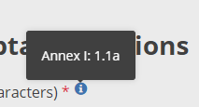
NATIONAL CIRCUMSTANCES (1)

Slide 29
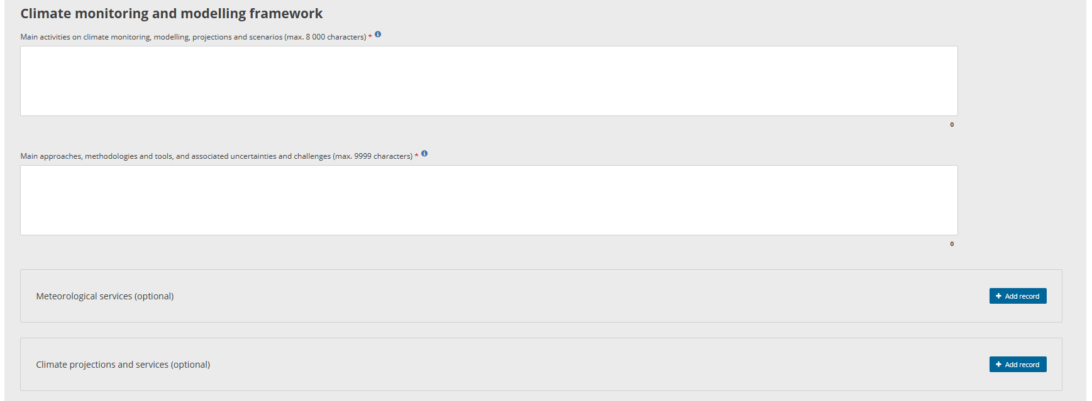
NATIONAL CIRCUMSTANCES (2)
!

Slide 30
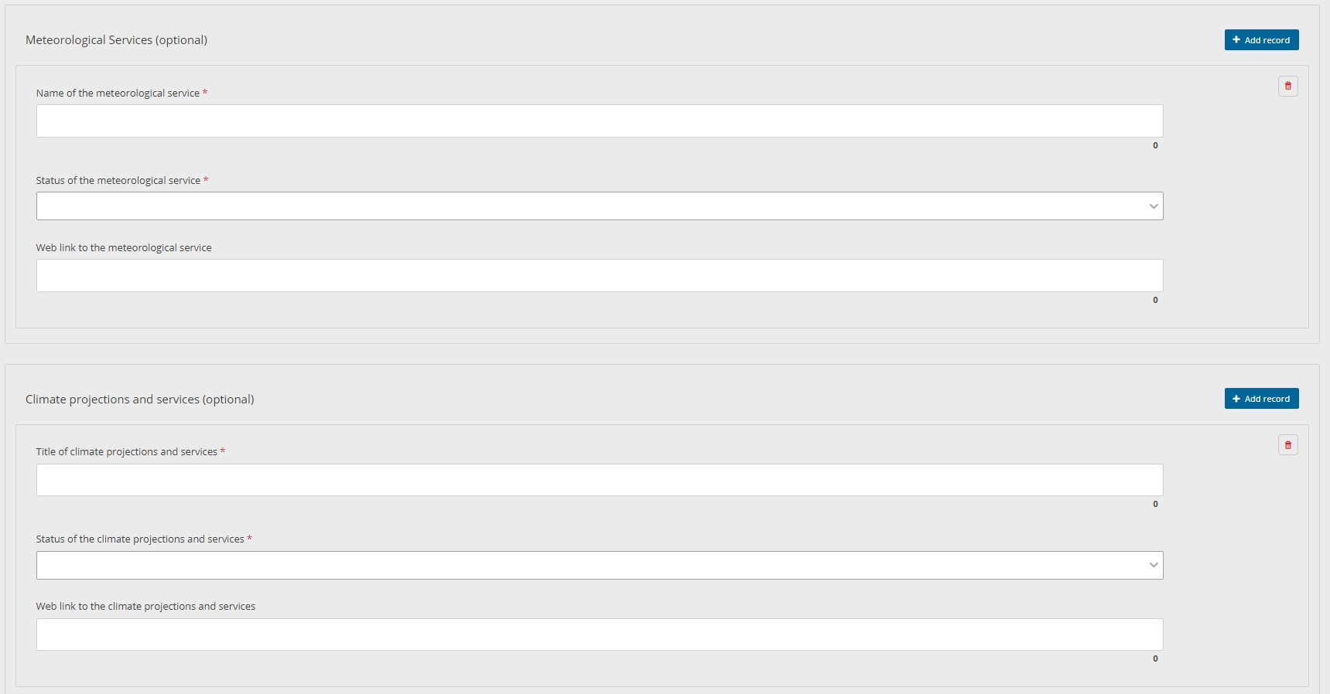
Meteorological services and Climate projections and services (optional)
Not a contradiction
“Conditional rules”: if a record is created, then these fields are mandatory However, the creation of a record is optional!

Slide 31
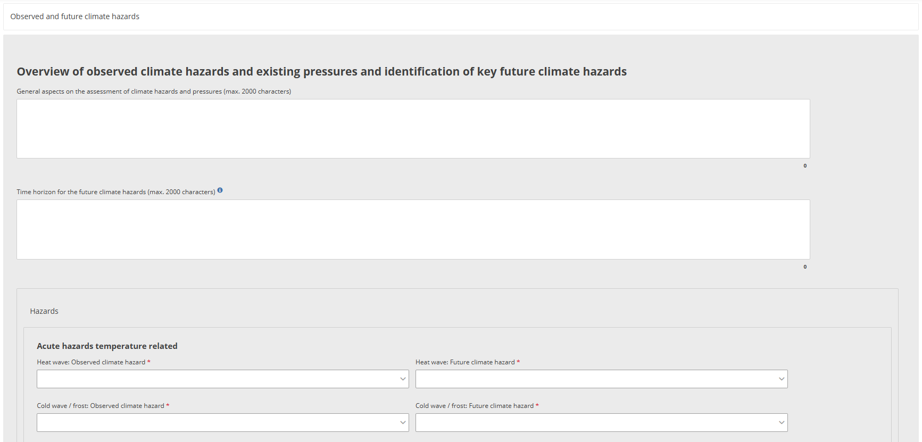
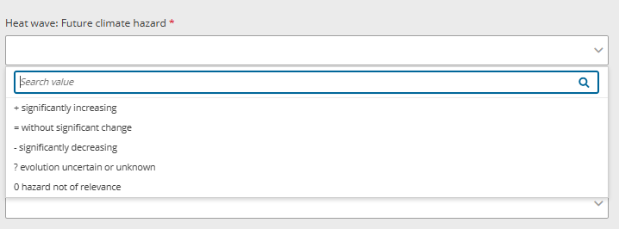
OBSERVED AND FUTURE CLIMATE HAZARDS (1)

Slide 32
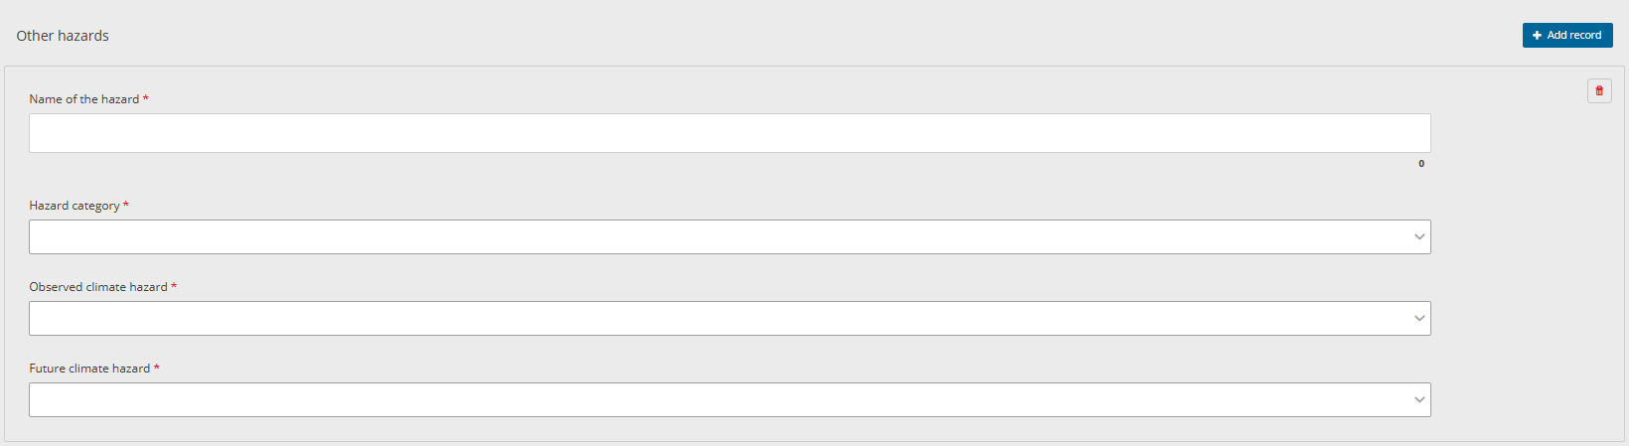
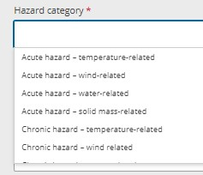
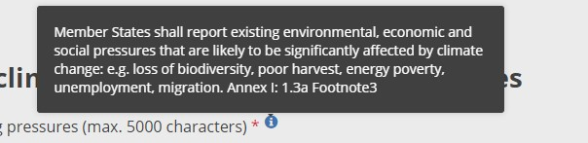
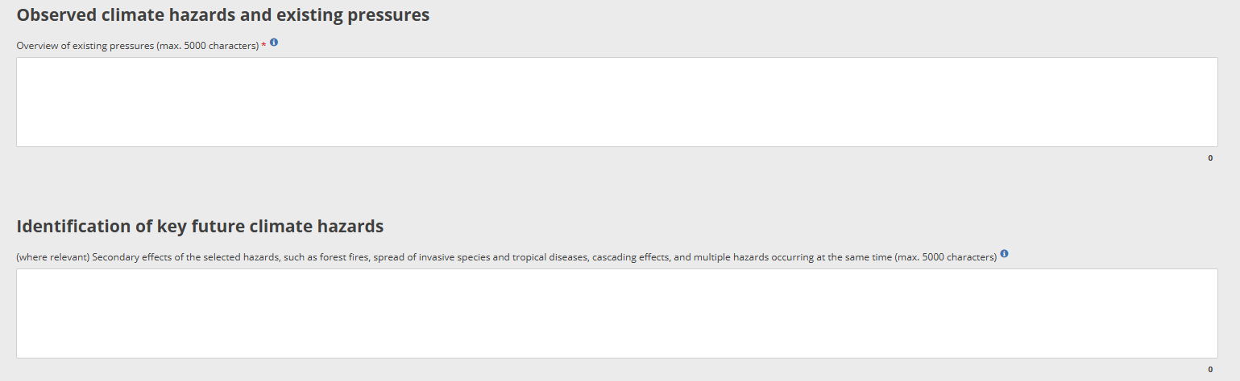
OBSERVED AND FUTURE CLIMATE HAZARDS (2)

Slide 33
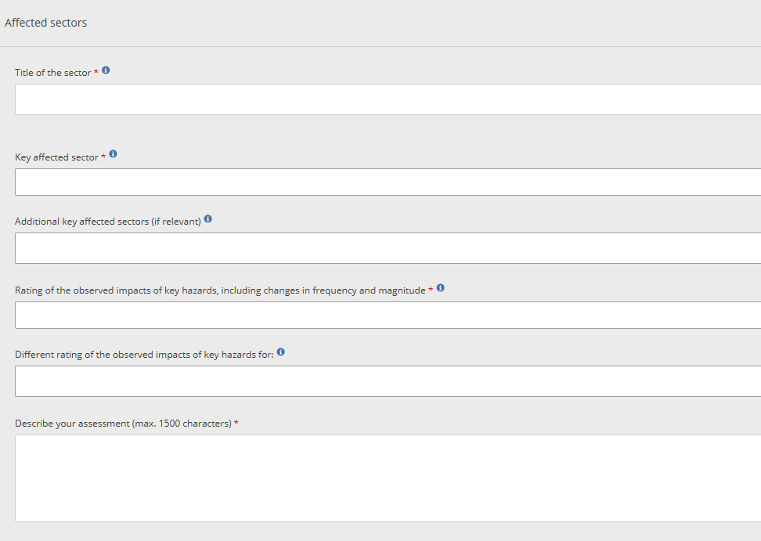
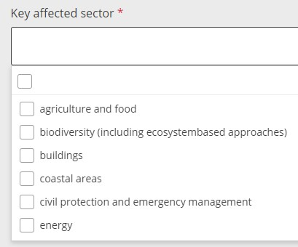
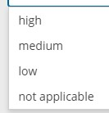
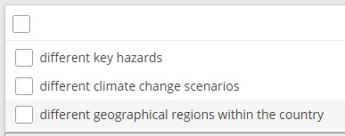
KEY AFFECTED SECTORS
Additional information in reporting guidelines

Slide 34
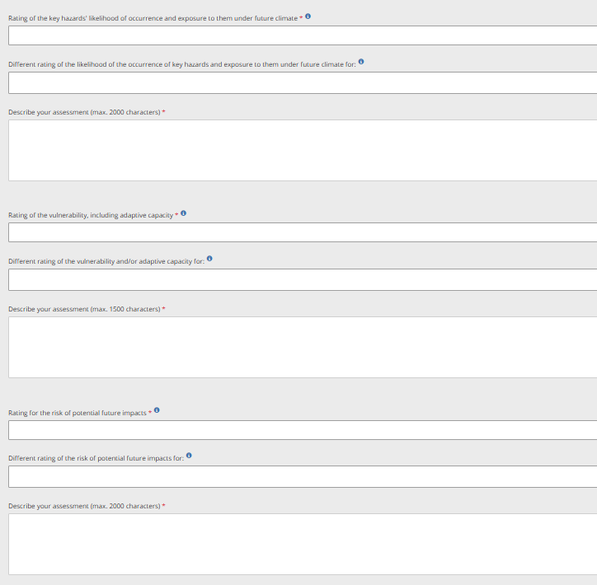
KEY AFFECTED SECTORS

Slide 35
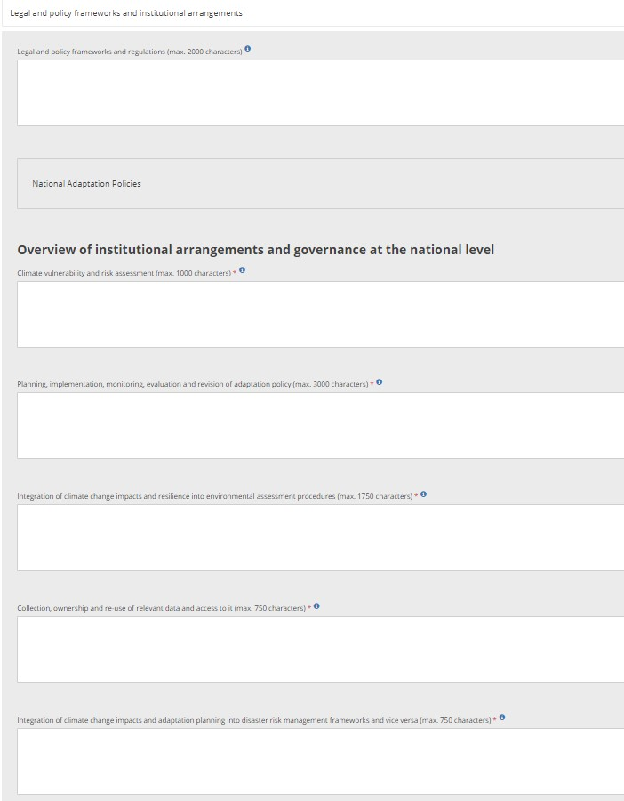
LEGAL AND POLICIES (1)
Legal and policy frameworks and regulations
National adaptation policies
Climate vulnerability and risk assessment
Planning, implementation, monitoring, evaluation and revision of adaptation policy
Integration of climate change impacts and resilience into environmental assessment procedures
Collection, ownership and re-use of relevant data and access to it
Integration of climate change impacts and adaptation planning into disaster risk management frameworks
Notes:
Touching on each step of the adaptation policy cycle

Slide 36
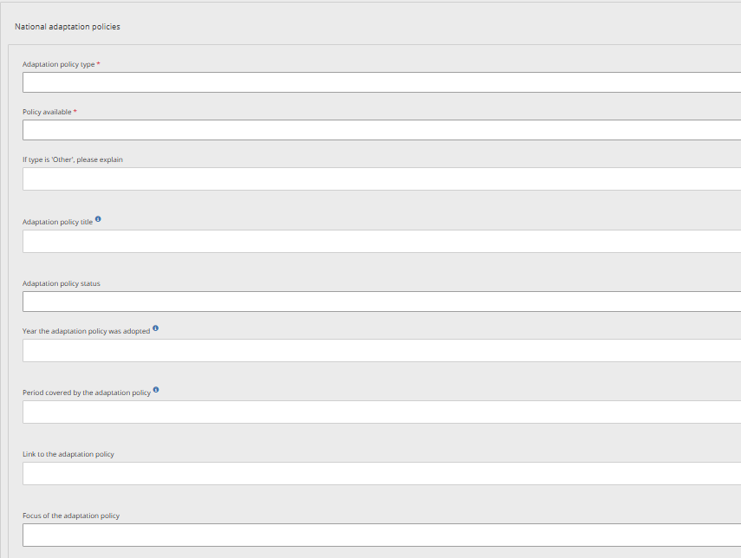
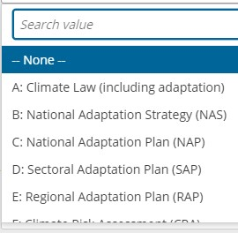
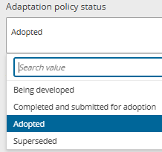
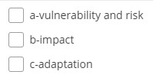
LEGAL AND POLICIES (2)
POLICY TABLE
‘Member States shall report the title, year of adoption and status [superseded / adopted / completed and submitted for adoption / being developed] of each NAS and NAP.’
Mandatory and conditional
Optional
Notes:
Policies developed or under development

Slide 37
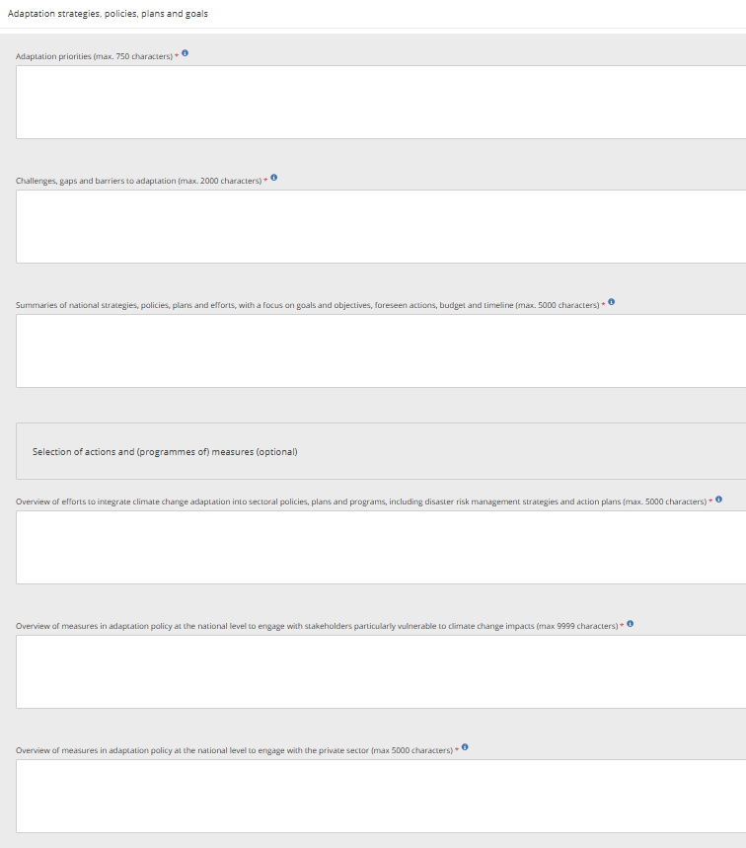
STRATEGIES AND PLANS (1)
Adaptation priorities
Challenges, gaps and barriers to adaptation
Summaries of national strategies, policies, plans and efforts, with a focus on goals and objectives, foreseen actions, budget and timeline
Overview of efforts to integrate climate change adaptation into sectoral policies, plans and programs, including disaster risk management strategies and action plans
Overview of measures in adaptation policy at the national level to engage with stakeholders particularly vulnerable to climate change impacts
Overview of measures in adaptation policy at the national level to engage with the private sector
Key type of measures (KTMs)
Notes:
Voluntary information but valuable since it provides an overview of priorities, gaps and challenges related to adaptation measures or actions. Prioritize reporting on specific actions that you want to highlight.
Link to documents even if in national languages
Provide synthesized information

Slide 38
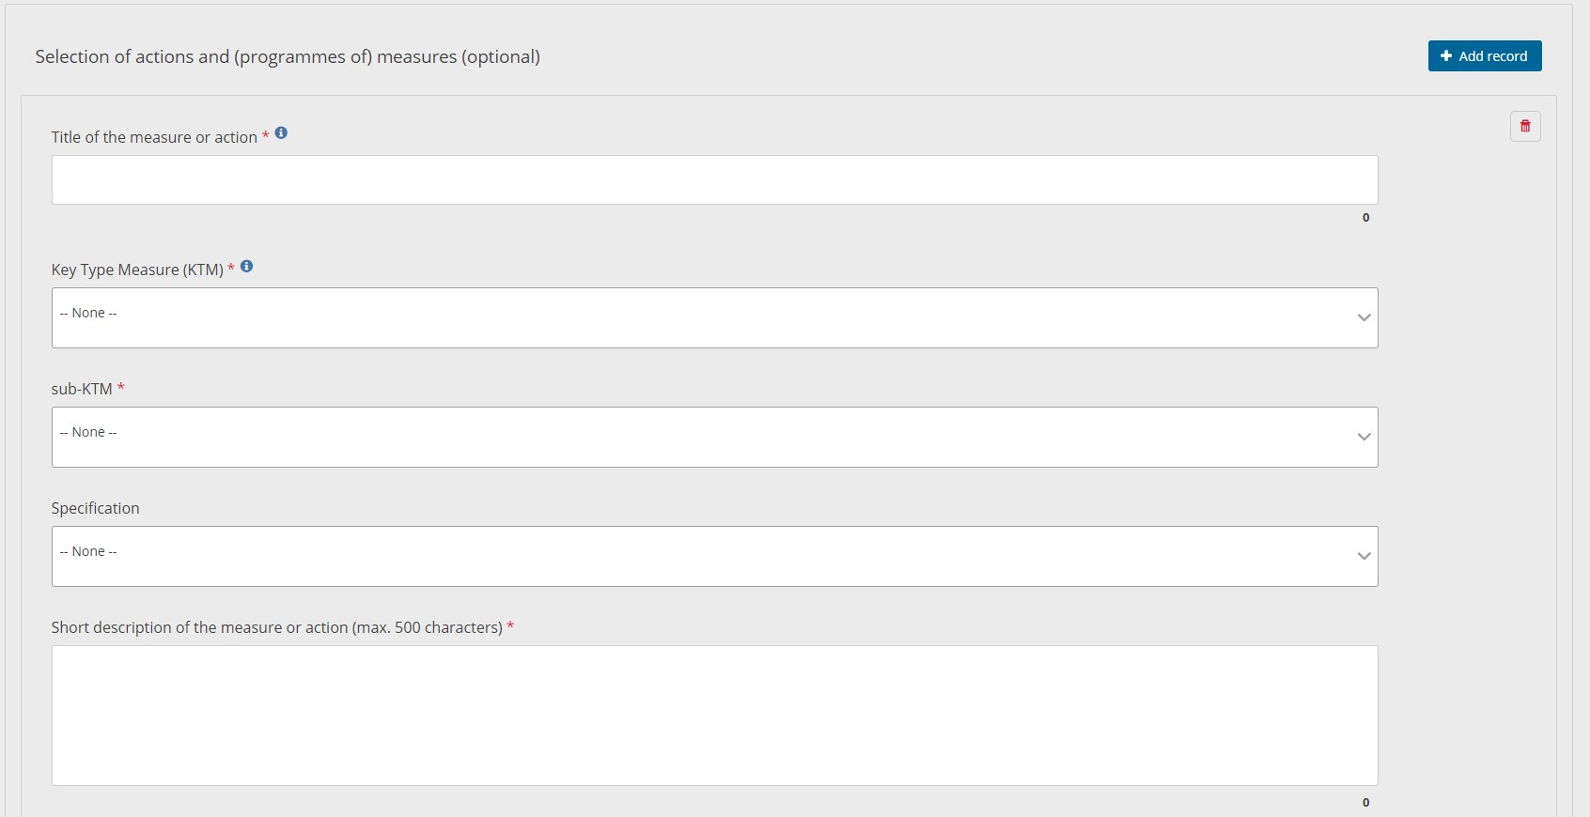
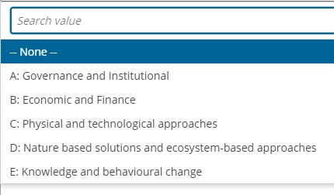
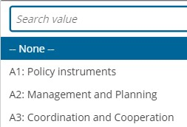

STRATEGIES AND PLANS - KTMs (2)
Voluntary additional information
D:NbS, D1: green options

Slide 39



STRATEGIES AND PLANS - KTMs (3)
Voluntary additional information
Observed and future climate hazards
Key affected sectors

Slide 40


MONITORING
AND EVALUATION (1)
Notes:
Any kind of quantitative or qualitative metrics to track progress

Slide 41




MONITORING AND EVALUATION (2)

Slide 42



COOPERATION AND EXPERIENCE
Notes:
Minimum of three good practices required

Slide 43


SUB-NATIONAL ADAPTATION
See “Cooperation and experience” webform

Slide 44

GENERAL INFORMATION (1)
1
2
3
NO need to attach key publications!

Slide 45






GENERAL INFORMATION (2)
1
2
3
Organisational
website
Notes:
Both for national and subnational uploads

Slide 46
Data Release

Slide 47

Before submitting
Validate (and refresh)
Correct “blockers and errors”, check “warnings”
Manage copies
Repeat until no more “blockers” or “errors”
On the top of the screen, click country name to leave “dataset” and go back to the overview page (also do this anytime you want to go back to the help files)

Slide 48
Data submission

Slide 49
Reporting on Article 19
Q&A

Slide 50

Break
(15 minutes)

Slide 51
Reporting on GovReg Article 17
Annex III Decarbonization - Adaptation
©TPeter Vadocz, Urban Treasures EEA
Notes:
As a minimum, Contracting Parties need to report on adaptation with regard to meeting the objectives and targets of the Energy Union and the Contracting Parties’ climate mitigation commitments under the Paris Agreement by stating:
1. Their adaptation goals in relation to ensuring the climate resilience of their actions to decarbonise (via decreasing GHG emissions and increasing removals), and, where applicable, to decarbonise through the use of renewable energy, increase energy efficiency, increase energy security, improve the internal energy market, and support research, innovation, and competitiveness.
2. Why each adaptation goal is relevant in that regard, i.e., the climate vulnerabilities and risks that it addresses and how it reduces them.
3. Progress with the implementation of each goal (i.e., output reporting) and, over the longer term, progress with reducing the climate vulnerabilities and risks (i.e., outcome reporting).
Such information can be drawn from the NECP or any other national policy documents containing relevant information.

Slide 52


Dataflow overview

Slide 53

Dataflow overview

Slide 54

TABLE 1 - ADAPTATION GOALS
Notes:
Adaptation goals set in national energy and climate plans
Goal of reporting is to track progress towards these goals
Goals in adaptation strategies can be referred to as well on a voluntary basis

Slide 55

TABLE 1 - ADAPTATION GOALS
Notes:
Can refer to other relevant documents as well but document has to be added in this table so that they can be linked to in the other tabs

Slide 56

TABLE 2 - NATIONAL CIRCUMSTANCES

Slide 57




Reporting on GHG emissions and removals under the Decarbonisation dimension is mandatory.
Other documents listed under the Adaptation goals webform will appear here.
Notes:
Reporting on the Decarbonisation dimension is mandatory
Reporting on the remaining dimensions are mandatory if applicable
Information should be reported separately for each dimension

Slide 58


Voluntary field

Slide 59


Reporting on GHG emissions and removals under the Decarbonisation dimension is mandatory.

Slide 60

TABLE 2 - STRATEGIES AND PLANS

Slide 61

Reporting on GHG emissions and removals under the Decarbonisation dimension is mandatory.

Slide 62

Voluntary field

Slide 63

Voluntary field

Slide 64

Voluntary field

Slide 65

TABLE 2 - MONITORING AND EVALUATION

Slide 66

Voluntary field

Slide 67


Voluntary field

Slide 68

Voluntary field

Slide 69

Reporting on GHG emissions and removals under the Decarbonisation dimension is mandatory only under the 'Progress of implementation towards meeting the adaptation goals' section.

Slide 70

Voluntary field

Slide 71


VALIDATIONS

Slide 72


BEFORE SUBMITTING
Validate (and refresh)
Do not close Reportnet while the validation is running. This may take some time.
Correct “blockers and errors”, check the “warnings” in the webforms
Repeat until there are no more “blockers” or “errors”
Manage copies
Save a copy
before you release your date
Download confirmation letter

Slide 73
Next steps and activities
©TPeter Vadocz, Urban Treasures EEA

Slide 74
2025 Activities
Q1
2025
Q2
2025
Q3
2025
Q4
2025
Reporting period
Quality assurance
Assessment
Product development
Opening the dataflows
Reporting ongoing
Training for reporters
Country support
Reporting period, reporting due 15 March
QAQC process
Feedback issued in April (or after submission)
Country support
Possible resubmissions in May
Assessment of information
Supporting EnCS products
Outcomes feeding into EEA products
Closing Article 17 dataflow
Publication of final EU datasets
EEA product development of the 2026 assessment report
Article 19 dataflow remains open
Country support with voluntary resubmissions

Slide 75
Reporting period
Q1
2025
Opening dataflows
Article 17 – open
Article 19 – open
Reporting period until 15 March
Training for reporters
Country support ongoing
When?
by 15 March
©TPeter Vadocz, Urban Treasures EEA

Slide 76




Q2
2025
Post-submission Quality Assurance and Quality Control
Voluntary feedback
Quality Assurance and Quality Control (QAQC)
EEA in cooperation with European Topic Centre on Climate Change Adaptation and LULUCF
Review submissions
Check for likely errors in data quality
Communicate with Contracting Parties
T
T
A
C
C
C
Timeliness
Contracting Parties to update submission
Transparency
Accuracy
Completeness
Consistency
When?
15 March – 31 May
Coherence

Slide 77







Q2
2025
Processing data
Country Profiles
Climate and Energy Portal
Stored in a database ~immediately
Data processing and harvesting
When?
1 June - 15 July
Notes:
Reports are made publicly available, so think about how you would like your data to be displayed publicly when putting together your reports.

Slide 78
Assessment
Q3
2025
Assessment of information
Supporting Energy Community Secretariat products Outcomes feeding into EEA products
Closing Article 17 dataflow
Publication of final EU datasets
When?
July - September
©TPeter Vadocz, Urban Treasures EEA

Slide 79
Product development
Q4
2025
EEA product development of the 2026 EEA reports
Closing Article 17 dataflow
Article 19 dataflow remains open
Country support with voluntary resubmissions
When?
October - December
©TPeter Vadocz, Urban Treasures EEA

Slide 80






EEA / ETC CA Publications on National adaptation policies and actions
2020
EEA Monitoring and evaluation of national adaptation policies throughout the policy cycle
2020
ETC-CA Rationale, approach and added value of Key Type of Measures for adaptation to climate change
2021
ETC-CA Using Key Type Measures to report climate adaptation action in the EEA member countries
2022
EEA Advancing towards climate resilience in Europe: status of reported national adaptation actions in 2021
ETC-CA Technical Paper 2/23
Is Europe on track with climate resilience? – Status of reported national adaptation actions in 2023
ETC-CA Report 2/2024 Characteristics and conditions of adaptation policy in EEA member and cooperating countries
2023 EEA briefing Is Europe on track towards climate resilience?
Upcoming EEA reports
When? Q1 2026
Notes:
Assessment of information published in 2025
Latest report on policy landscape includes also the 6 WB CPs

Slide 81
Helpdesk
aneliya.nikolova@eea.europa.eu
First point of contact
Thematic issues with data input
Information on renomination of lead reporters
All dataflow experts will respond via this mailbox
OR
servicedesk@eea.europa.eu
IT/Technical Reportnet issues (crashes, bugs etc.)
©TPeter Vadocz, Urban Treasures EEA

Slide 82

?
Notes:
All

